Slide 1
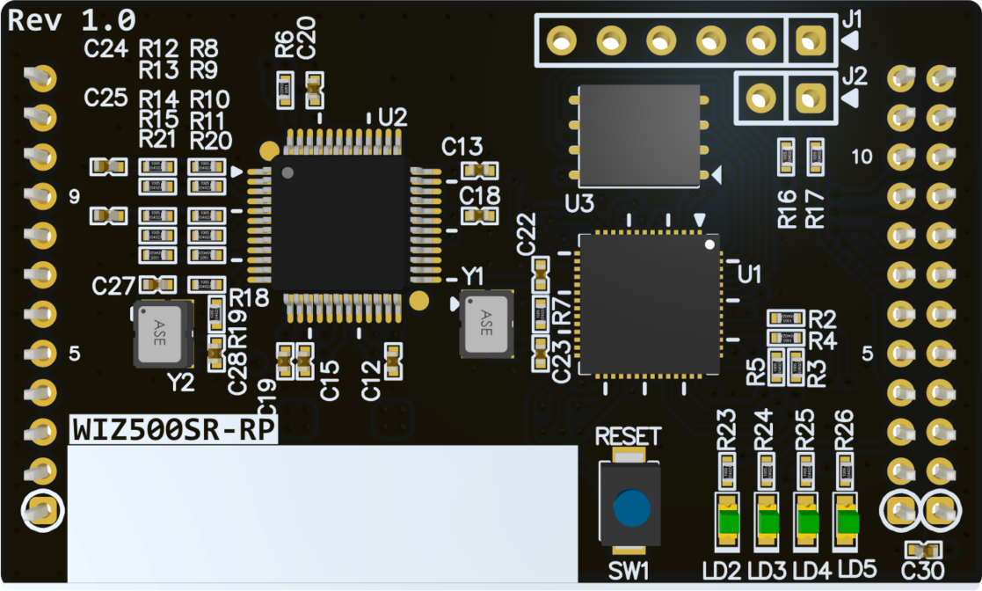
WIZ500SR-RP 3D(TOP)

Slide 2
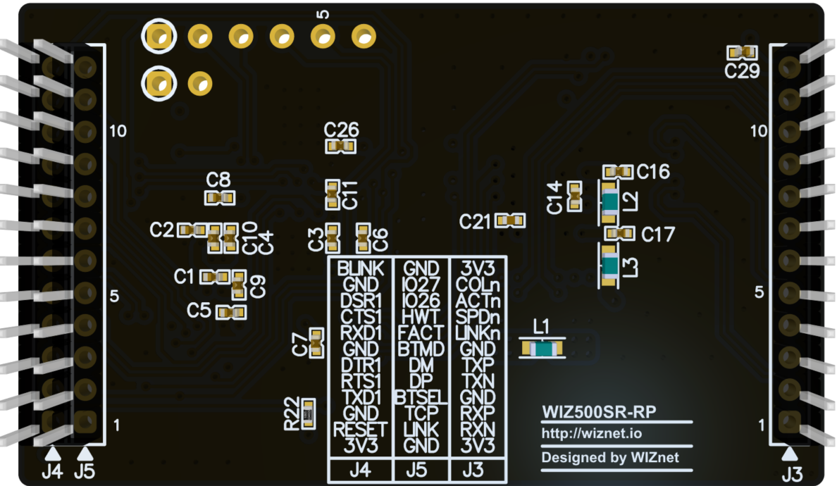
WIZ500SR-RP 3D(BOT)

Slide 3
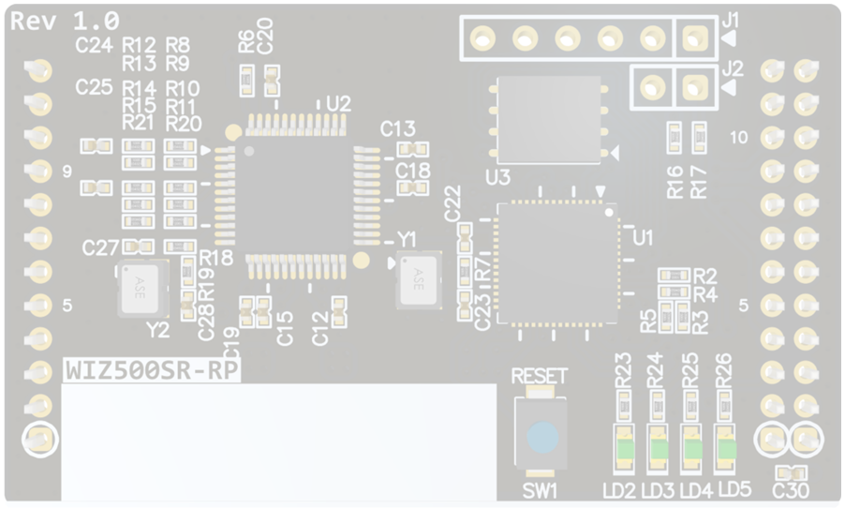
WIZ500SR-RP Callout Top
U6
Flash Memory
J1
DEBUG
(Not Mount)
J2
BOOTSEL
(Not Mount)
U2
W5100S
U1
RP2040
SW1
RESET
LD1~4
Indicade LED

Slide 4
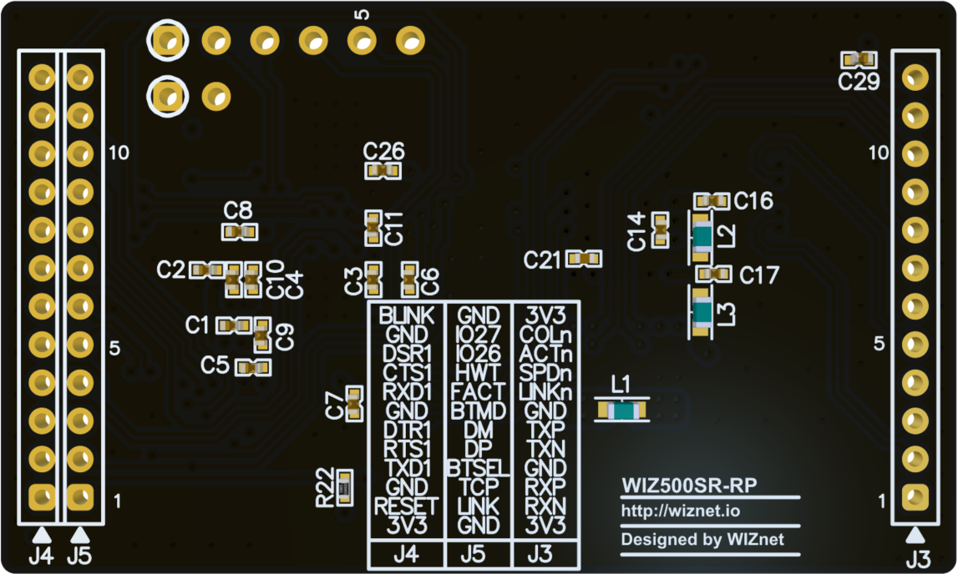
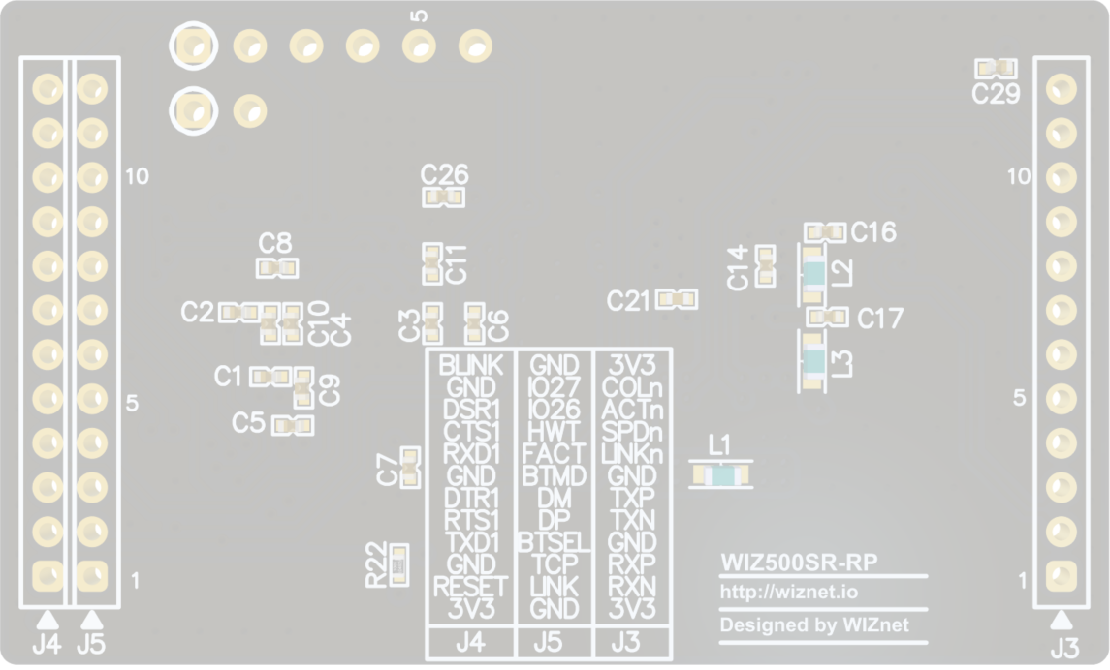
WIZ500SR-RP Callout BOT
J4
UART1
J5
Download, Signal
J3
Network Line

Slide 5
J1
3V3
UART0 TX
UART0 RX
SWCLK
SWDIO
GND
J3
J4
3V3
J2
BLINK
COLn
GND
GND
ACTn
BOOTSEL
UART1 DSR
SPDn
J5
UART1 CTS
LINKn
GND
UART1 RX
GND
Reserved
GND
TX_P
Reserved
UART1 DTR
TX_N
HW_TRIG
UART1 RTS
GND
FACT_RST
UART1 TX
RX_P
BOOTMODE
GND
RX_N
USB_DM
RUN
3V3
USB_DP
3V3
BOOTSEL
TCP_STATUS
LINK_STATUS
GND
WIZ500SR-RP Pinout Top

Slide 6
J1
3V3
UART0 TX
UART0 RX
SWCLK
SWDIO
GND
WIZ500SR-RP (J1-Pinmap)

Slide 7
J2
GND
BOOTSEL
WIZ500SR-RP (J2-Pinmap)

Slide 8
J3
3V3
COLn
ACTn
SPDn
LINKn
GND
TX_P
TX_N
GND
RX_P
RX_N
3V3
WIZ500SR-RP (J3-Pinmap)

Slide 9
J4
BLINK
GND
UART1 DSR
UART1 CTS
UART1 RX
GND
UART1 DTR
UART1 RTS
UART1 TX
GND
RUN
3V3
WIZ500SR-RP (J4-Pinmap)

Slide 10
J5
GND
Reserved
Reserved
HW_TRIG
FACT_RST
BOOTMODE
USB_DM
USB_DP
BOOTSEL
TCP_STATUS
LINK_STATUS
GND
WIZ500SR-RP (J5-Pinmap)

Slide 11
WIZ500SR-RP LED
LD5
LD4
LD3
LD2

Slide 12
WIZ500SR-RP RESET
SW1
RESET

Slide 13
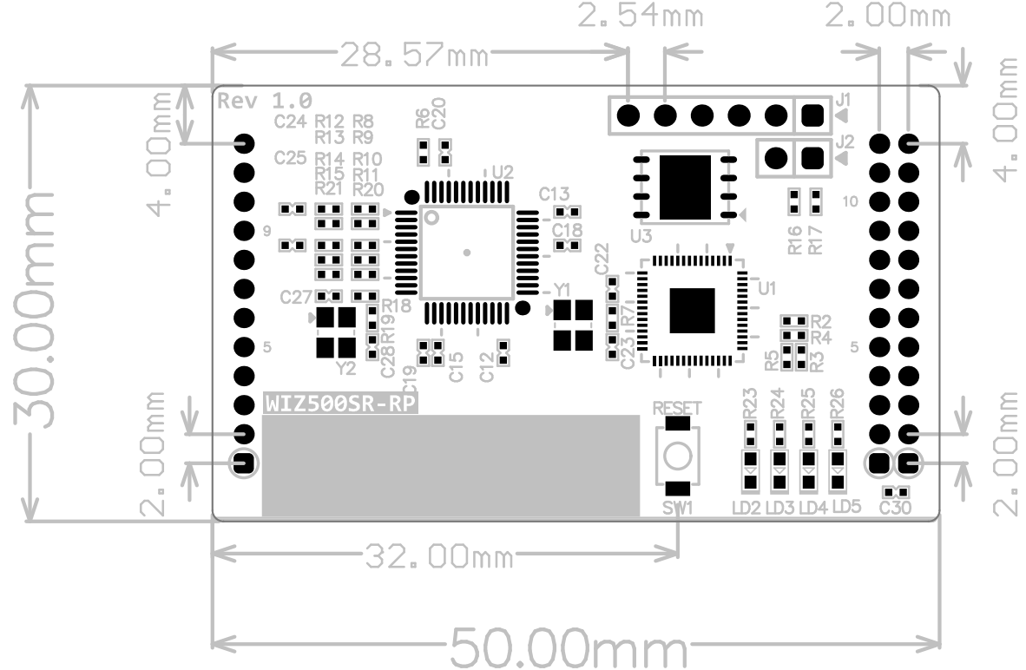
WIZ500SR-RP Dimension

Slide 14
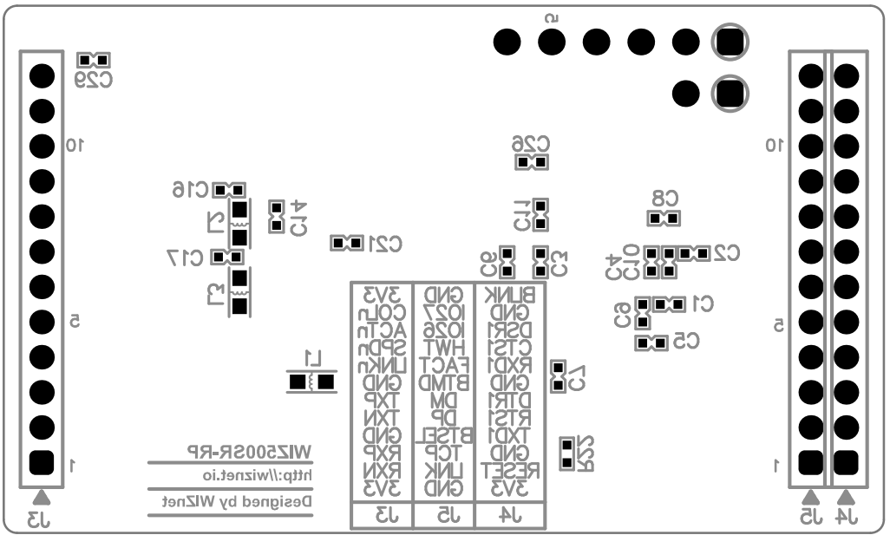
WIZ500SR-RP Dimension

